Slide 1
KT Initiation
By Shubham Kumar

Slide 2
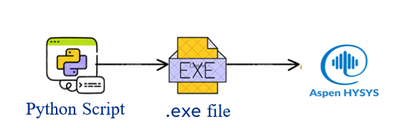
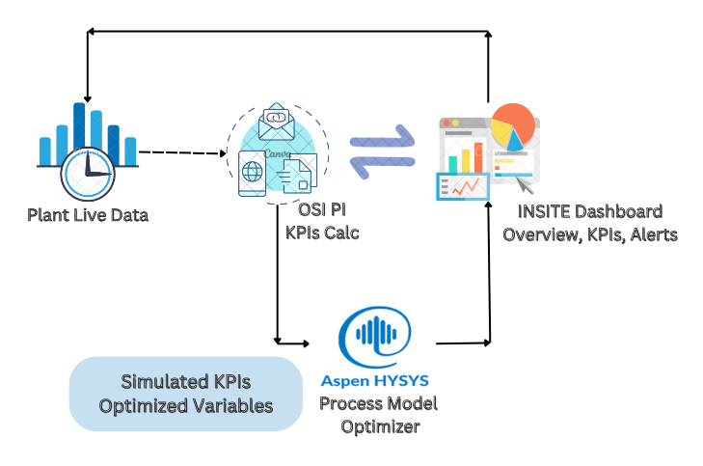
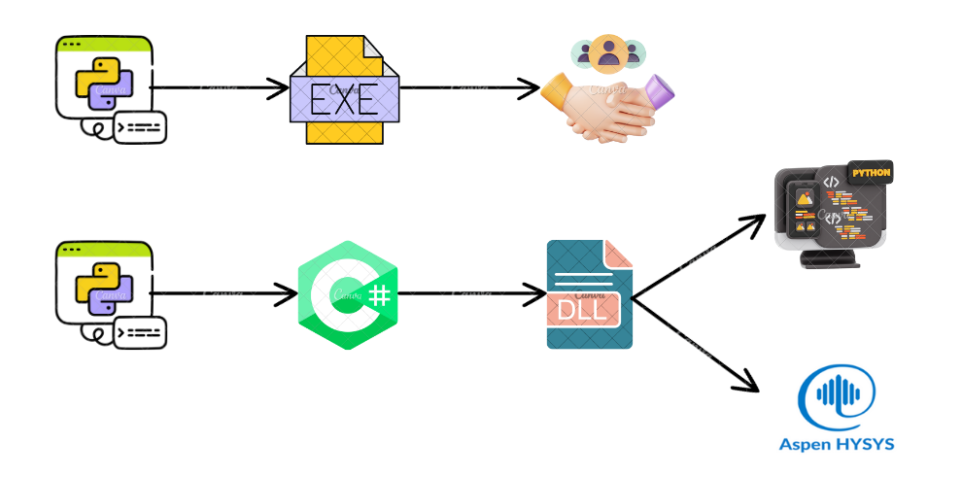

Creation of Dynamic link library files
Python Script
.exe file
Use as a library
Python Script
C Sharp
.dll or .pyd file
Use for simulation
Tools required VS Code and some extensions

Slide 3
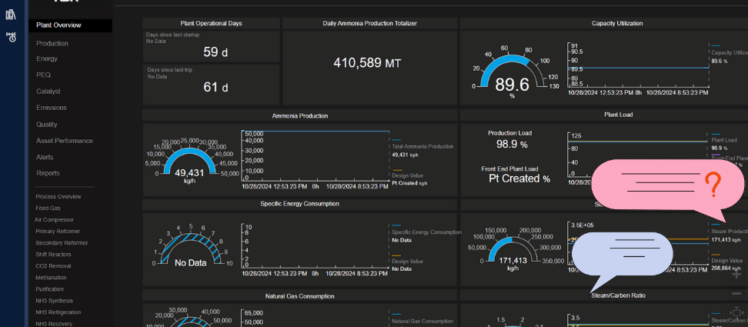
Building a Chatbot Using HABILIS
Chatbot

Slide 4
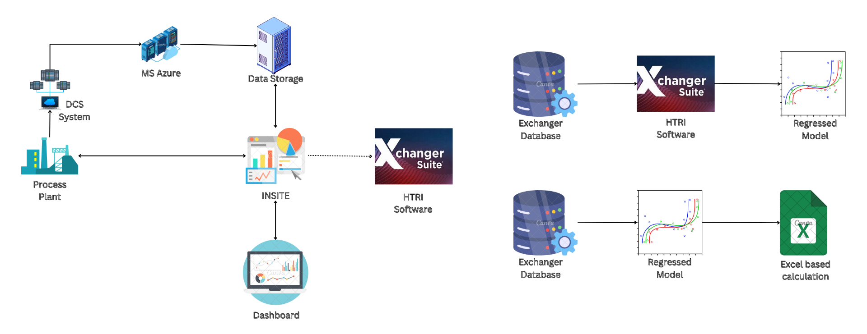
HTRI use case for fouling calculation
Tools required HTRI and Excel VBA

Slide 5
THANK YOU

Slide 6
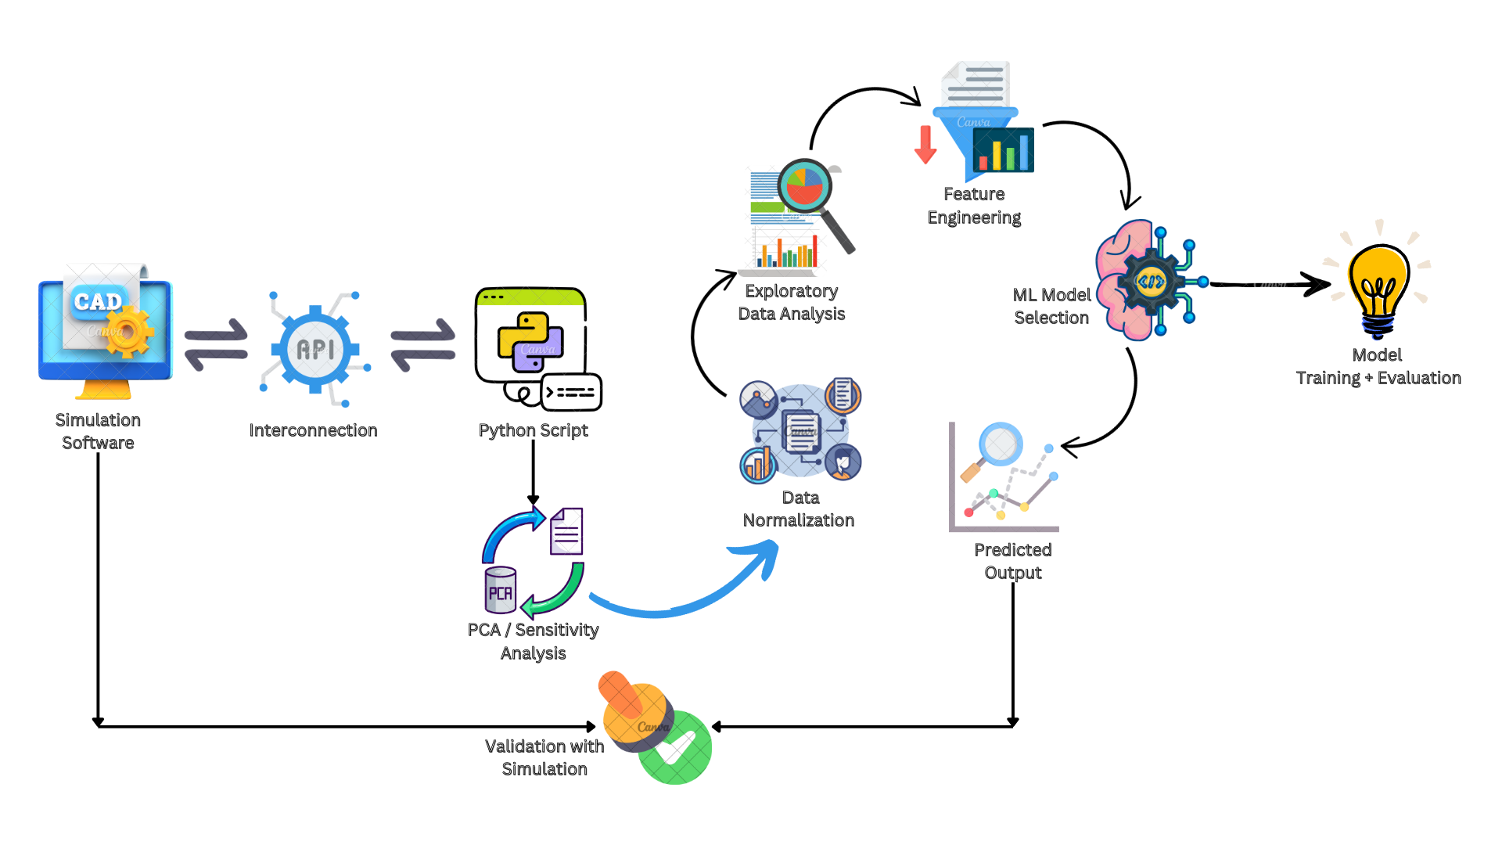
AI/ML Integration for Process Optimization
Tools required VS Code and Excel VBA

